Slide 1
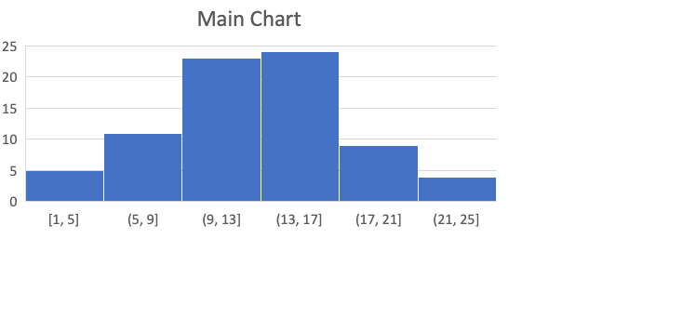

Slide 2
Please Select
All
Male
Female
Infant

Slide 3
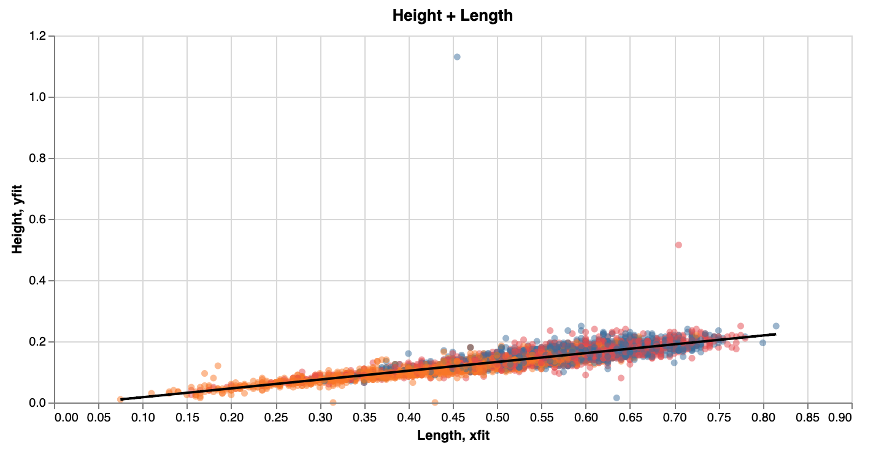
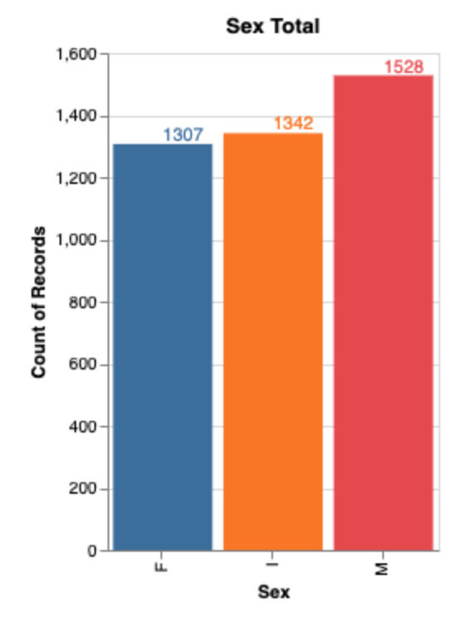

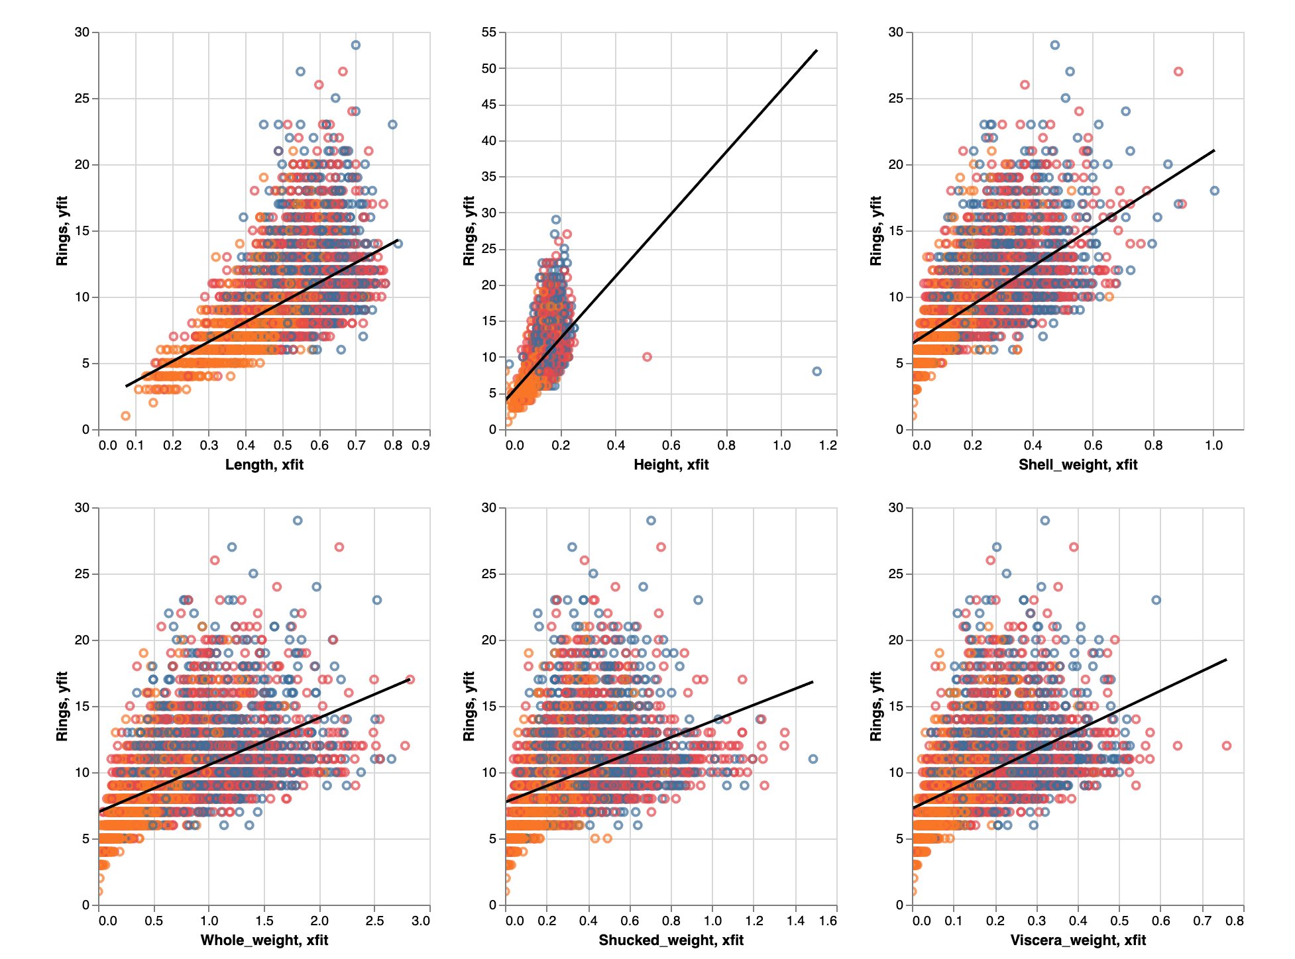

Slide 4
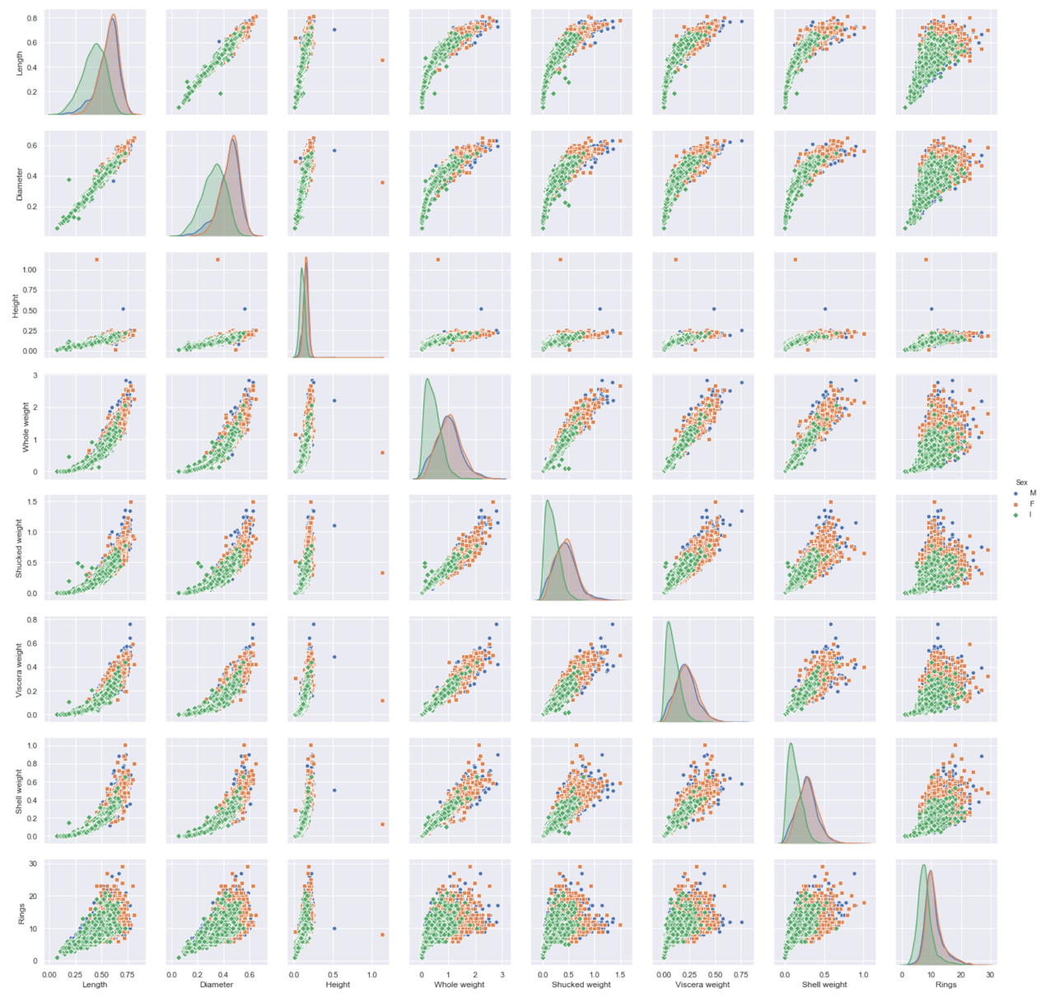

Height
Length
Diameter
Whole Weight
Shucked Weight
Viscera Weight
Shell Weight
Rings

